Slide 1
14
Options and Corporate Finance

Slide 2

Chapter 14 – Index of Sample Problems
Slide # 02 - 06 Put option
Slide # 07 - 12 Call option
Slide # 13 - 16 Call expiration value
Slide # 17 - 23 Current value of call option
Slide # 24 - 29 Equity as a call option
Slide # 30 - 34 Option to wait
Slide # 35 - 41 Option to abandon
Slide # 42 - 48 Convertible bonds

Slide 3
2: Put option
You currently own 1,000 shares of BPR, Inc. stock. You would like to have the option to sell these shares for $35 each anytime between now and July.
What type of option order might you place in this situation?

Slide 4
3: Put option
You currently own 1,000 shares of BPR, Inc. stock. You would like to have the option to sell these shares for $35 each anytime between now and July.
Do you want to be the party that determines if the option is exercised?
Do you want to buy or sell shares of stock?
How many shares of stock do you want to trade?
What price are you looking for?

Slide 5
4: Put option
Do you want to be the party that determines if the option is exercised?
Answer: Yes
Effect: You must be the buyer of the option contract.
Do you want to buy or sell shares of stock?
Answer: Sell
Effect: You need to buy a put option.

Slide 6
5: Put option
How many shares of stock do you want to trade?
Answer: 1,000
Effect: You need 10 contracts.
What price are you looking for?
Answer: $35
Effect: You need an exercise price of $35.

Slide 7
6: Put option
How long do you want to have this option in effect?
Answer: Until July
Effect: You need July contracts.
Can you put it all together to describe the option contract that fits your situation?
Answer: Yes!
Effect: You need to buy 10 July 35 put options.

Slide 8
7: Call option
Expiration Month | Strike Price | Call Price
Apr | 25 | .50
May | 25 | .80
Jun | 25 | 1.15
You want to buy May call options on 500 shares of stock. How much will you have to pay to acquire these options? Ignore commission costs.

Slide 9
8: Call option
Expiration Date | Strike Price | Call Price Per Share
May | 25 | .80
You want to buy May call options on 500 shares of stock. How much will you have to pay to acquire these options?
Total cost = 500 × .80
= $400

Slide 10
9: Call option
Expiration Date | Strike Price | Call Price
Apr | 25 | .50
May | 25 | .80
Jun | 25 | 1.15
This morning, you purchased a June call option contract at the price shown. Assume that you immediately exercise this contract. How much will you spend in total to acquire each share of stock, ignoring commissions?

Slide 11
10: Call option
Expiration Date | Strike Price | Call Price
Jun | 25 | 1.15
This morning, you purchased a June call option contract at the price shown. Assume that you immediately exercise this contract. How much will you spend in total to acquire each share of stock?
Total cost per share = $1.15 + $25.00
=$26.15
(ignoring commissions and trading costs)

Slide 12
11: Call option
Last week, you purchased six call option contracts with a strike price of $20 and an option price of $3. Today, the stock is selling for $28 a share.
How much total profit will you make if you exercise your options today and then sell your shares of stock?

Slide 13
12: Call option
Last week, you purchased six call option contracts with a strike price of $20 and an option price of $3. Today, the stock is selling for $28 a share. How much total profit will you make if you exercise your options today and then sell your shares of stock?
Total profit = 6 × 100 × ($28 - $3 - $20)
= 600 × $5
= $3,000
(ignoring commissions and trading costs)

Slide 14
13: Call expiration value
You own a call option on ABC stock. The call has an exercise price of $35.
What is the value of this option at expiration if ABC stock is selling for $34 a share at that time?

Slide 15
14: Call expiration value
You own a call option on ABC stock. The call has an exercise price of $35. What is the value of this option at expiration if ABC stock is selling for $34 a share at that time?
C₁=0 if S₁ ≤ E
This says that the call is worthless on the expiration date when the stock price is less than the exercise price, which it would be in this case.

Slide 16
15: Call expiration value
You own a call option on XYZ stock. The call has a strike price of $20.
What is the value of this option at expiration if XYZ stock is selling for $22 a share at that time?

Slide 17
16: Call expiration value
You own a call option on XYZ stock. The call has a strike price of $20. What is the value of this option at expiration if XYZ stock is selling for $22 a share at that time?
C₁ = S₁ - E if S₁ > E
C₁=$22 - $20
= $2
This says that the option price on the expiration date is equal to the stock price minus the exercise price whenever the stock price is greater than the exercise price.

Slide 18
17: Current value of call option
Assume that you own a call option that expires in one year. The exercise price of the call is $60. The risk-free rate is 4%. The current price of the stock is $87. Assume that the option will expire in the money.
What is the current value of the call option?

Slide 19
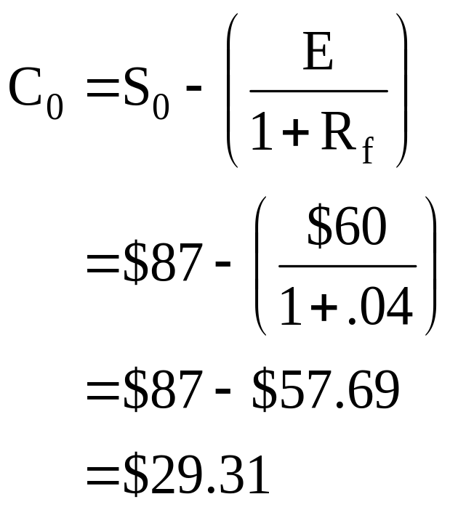
18: Current value of call option
Assume that you own a call option that expires in one year. The exercise price of the call is $60. The risk-free rate is 4%. The current price of the stock is $87. Assume that the option will expire in the money. What is the current value of the call option?

Slide 20
19: Current value of call option
KNF stock is currently selling for $30 a share. The stock price is expected to be either $32 or $38 a share one year from now. The risk-free rate is 10%. You own a stock option on KNJ with an exercise price of $35.
What is the value of one option today?

Slide 21
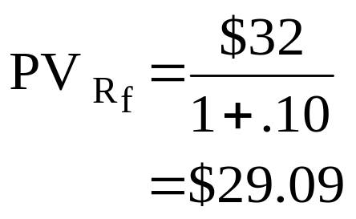
20: Current value of call option
The KNF stock is currently selling for $30 a share. The stock price is expected to be either $32 or $38 a share one year from now. The risk-free rate is 10%. You own a stock option on KNJ with an exercise price of $35. What is the value of one option today?
You invest $29.09 today in a risk-free asset.
This asset will be worth $32 in one year.
The risk-free asset will be equal in value to the lowest expected
stock price one year from now.

Slide 22
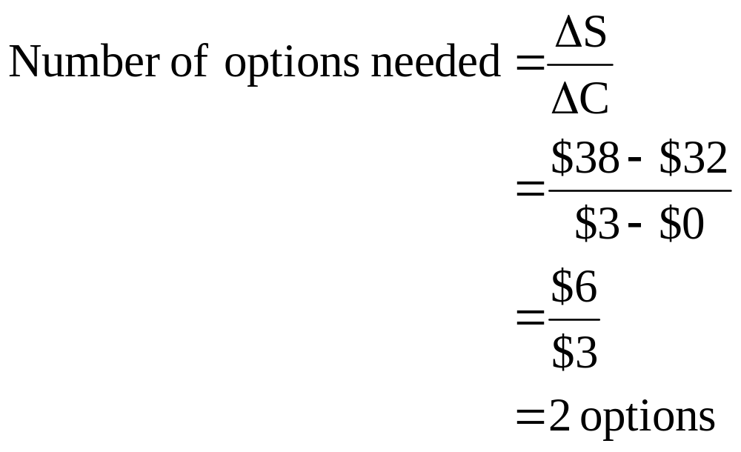
21: Current value of call option

Slide 23
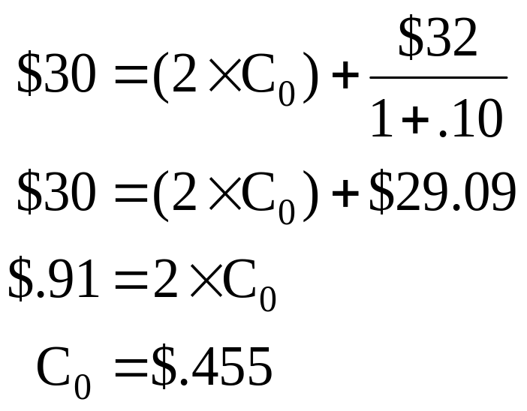
22: Current value of call option

Slide 24
23: Current value of call option
If the stock price is $32, then:
Risk-free asset = $32
Options = $ 0 ($32 is less than the exercise price of $35.)
Total position = $32
If the stock price is $38, then:
Risk-free asset = $32
Options = $ 6 ($38 - $35 = $3; $3 × 2 = $6)
Total position = $38

Slide 25
24: Equity as a call option
The assets of the Limelite Co. are currently worth $1,050. These assets are expected to be worth either $900 or $1,200 one year from now. The company has a pure discount bond outstanding with a $1,000 face value. The bond matures in one year. The risk-free rate is 8%.
What is the value of the equity in this firm?
What is the value of the debt?

Slide 26
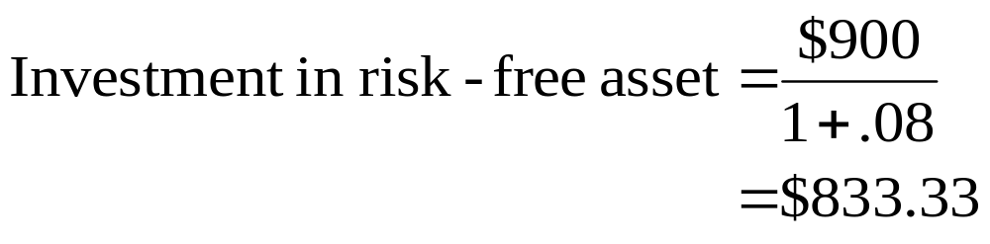
25: Equity as a call option
Step 1. Invest the present value of the lower asset value
in one year at the risk-free rate of return.

Slide 27
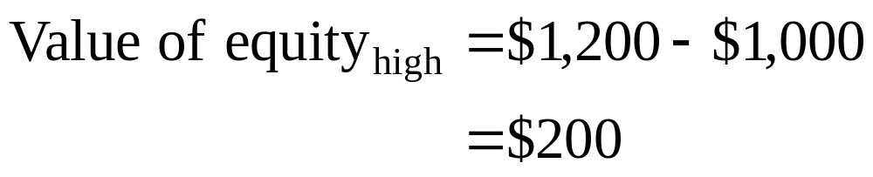
26: Equity as a call option
Step 2. Determine the value of the equity in the firm one
year from now assuming that the assets are worth
the higher of the two possible amounts

Slide 28
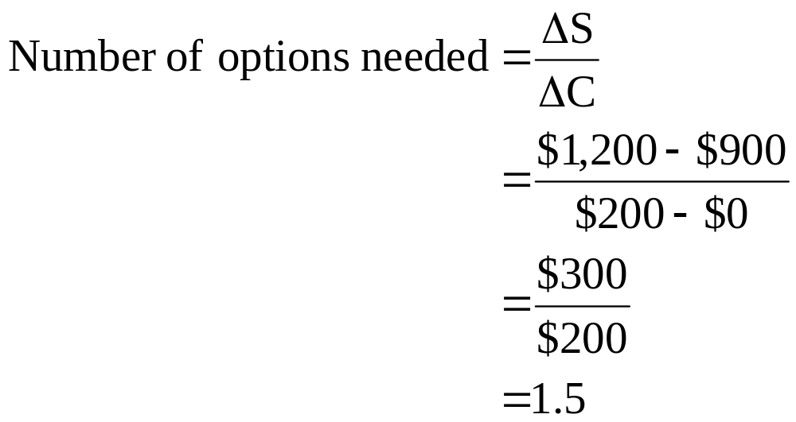
27: Equity as a call option
Step 3. Determine the number of options needed

Slide 29
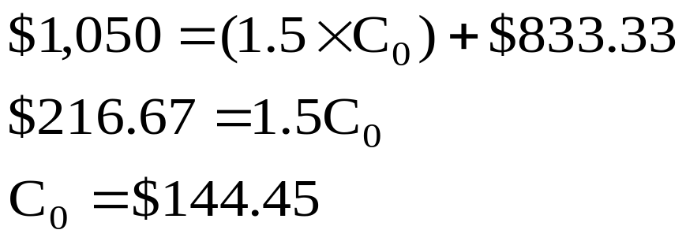
28: Equity as a call option
Step 4. Determine the option value, which is the value of
the equity

Slide 30
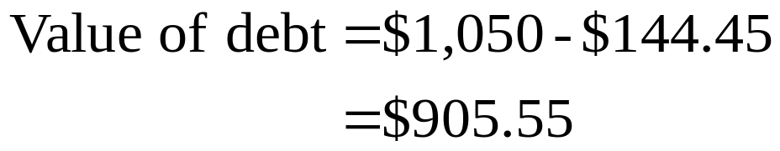
29: Equity as a call option
Step 5. Determine value of the debt

Slide 31
30: Option to wait
Jasper and Company are considering a new project which has an initial cost of $600. If they wait one year, the project cost will rise to $625. If they start the project today, it will produce cash inflows of $300 a year for three years. If they wait one year to start the project, it will produce cash inflows of $350 a year for three years. The discount rate for this project is 10%.
What is the value of the option to wait?

Slide 32
31: Option to wait
What is the net present value of the project if they start it today?
What is the net present value of the project if they wait and start it one year from now?
What is the value of the option to wait?

Slide 33
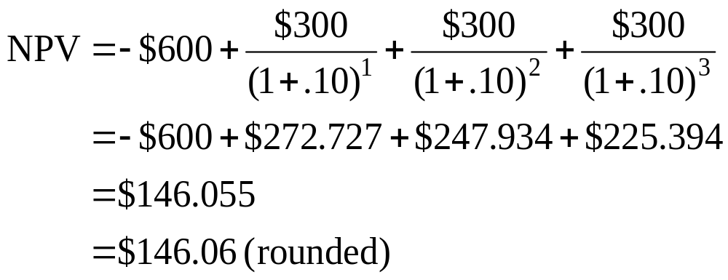
32: Option to wait
What is the net present value of the project if they start it today?

Slide 34
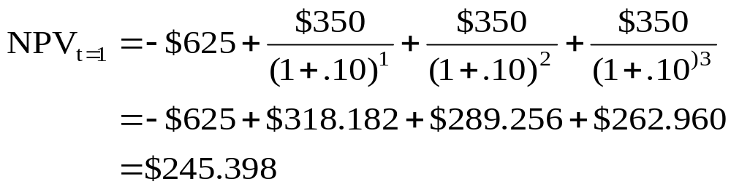
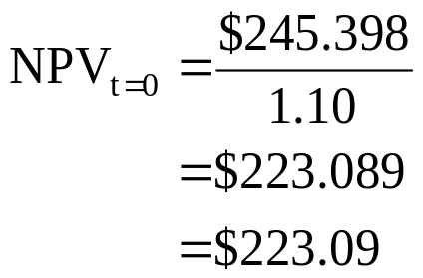
33: Option to wait
What is the net present value of the project if they wait and start it one year from today?

Slide 35

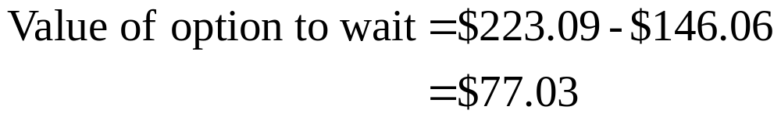
34: Option to wait
What is the value of the option to wait?

Slide 36
35: Option to abandon
You are considering a project with an initial cost of $220,000. You expect to sell 3,000 units a year for 5 years. The net cash flow per unit is $20. The rate of return is 10%.
What is the base case net present value of this project?

Slide 37
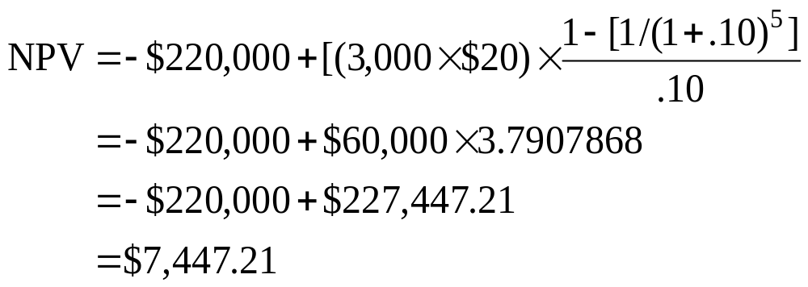
36: Option to abandon
You are considering a project with an initial cost of $220,000. You expect to sell 3,000 units a year for 5 years. The net cash flow per unit is $20. The rate of return is 10%. What is the base case net present value of this project?

Slide 38
37: Option to abandon
You are considering a project with an initial cost of $220,000. You expect to sell 3,000 units a year for 5 years. The net cash flow per unit is $20. The rate of return is 10%.
Now assume that you can abandon this project after two years at which time the project can be sold for $110,000.
At what level of sales would you be willing to abandon this project?

Slide 39
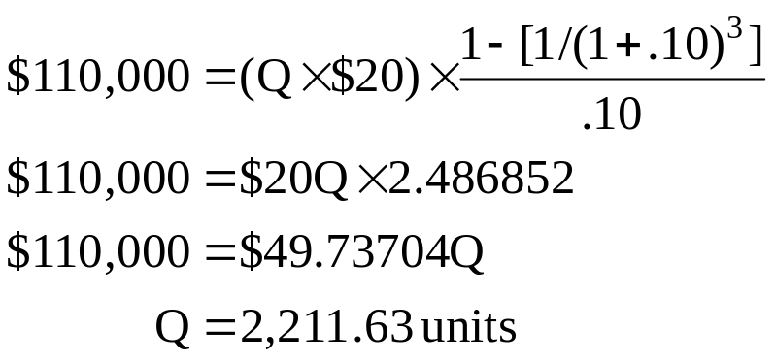
38: Option to abandon
You are considering a project with an initial cost of $220,000. You expect to sell 3,000 units a year for 5 years. The net cash flow per unit is $20. The rate of return is 10%. Now assume that you can abandon this project after two years at which time the project can be sold for $110,000. At what level of sales would you be willing to abandon this project?

Slide 40
39: Option to abandon
You are considering a project with an initial cost of $220,000. You expect to sell 3,000 units a year for 5 years. The net cash flow per unit is $20. The rate of return is 10%. Now assume that you can abandon this project after two years at which time the project can be sold for $110,000.
Suppose now that you expect sales to be either 2,000 units or 4,000 units per year starting in year three of the project. You place 50/50 odds on these estimates.
What is the net present value of this project given these new assumptions?

Slide 41
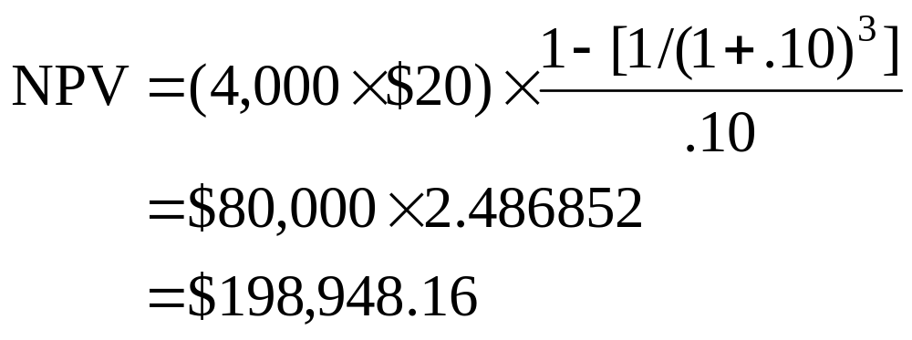
40: Option to abandon
If the sales quantity is 2,000 units, you will abandon the project and receive $110,000.
If the sales quantity is 4,000 units, you will continue the project. The project will have a net present value of $198,948.16 at that time.

Slide 42
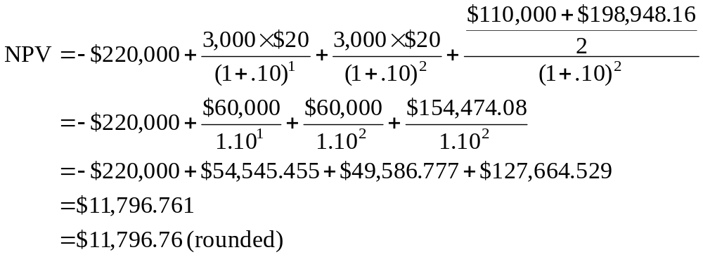
41: Option to abandon

Slide 43
42: Convertible bonds
A bond with a $1,000 face value can be converted into 40 shares of common stock.
What is the conversion price?

Slide 44
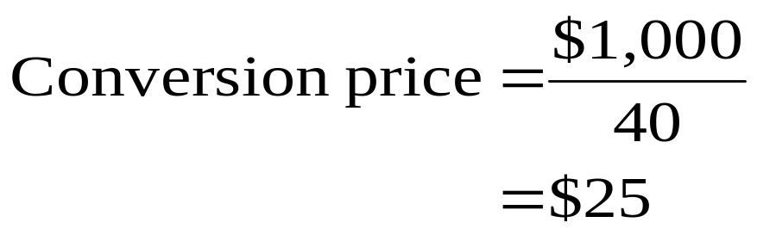
43: Convertible bonds
A bond with a $1,000 face value can be converted into 40 shares of common stock. What is the conversion price?

Slide 45
44: Convertible bonds
Suzette owns 500 convertible bonds. These bonds have a face value of $1,000, a 6% coupon and a maturity date of 10 years. The bonds are convertible into shares of common stock at a conversion price of $36.525.
How many shares of stock will Suzette receive if she converts all of her bonds?

Slide 46
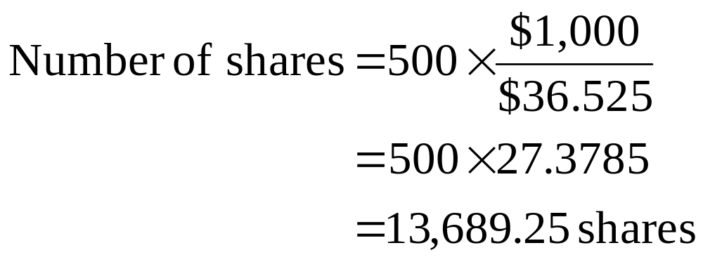
45: Convertible bonds
Suzette owns 500 convertible bonds. These bonds have a face value of $1,000, a 6% coupon and a maturity date of 10 years. The bonds are convertible into shares of common stock at a conversion price of $36.525. How many shares of stock will Suzette receive if she converts all of her bonds?

Slide 47
46: Convertible bonds
Mary owns a convertible bond that matures in 8 years. The bond has a face value of $1,000, a 6% coupon and pays interest semi-annually. The conversion price is $42.16. The current price of the stock is $43.03. The market return on similar bonds is 8%.
What is the straight bond value?
What is the conversion value?

Slide 48
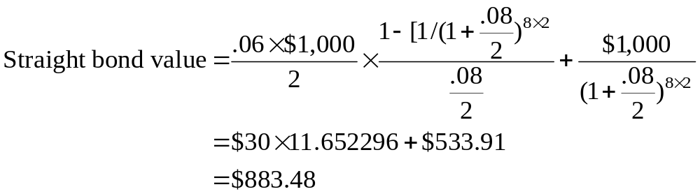
47: Convertible bonds
Enter 8×2 8/2 60/2 1,000
N I/Y PV PMT FV
Solve for ±883.48

Slide 49
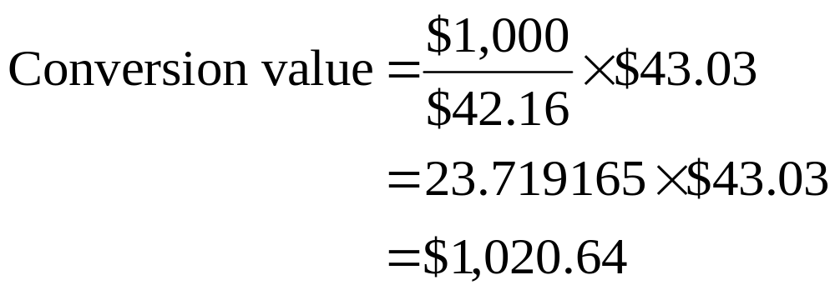
48: Convertible bonds
Mary owns a convertible bond that matures in 8 years, has a face value of $1,000, a 6% coupon and pays interest semi-annually. The conversion price is $42.16. The current price of the stock is $43.03.

Slide 50
14
End of Chapter 14

